Slide 1
Osseointegrated Hearing Devices & Outcomes
Stephanie Malone, B. A.
smalone@pennstatehealth.psu.edu
Notes:
Good afternoon, thank you all for coming out. I am Stephanie Malone, the fourth year audiology extern at Penn State Hershey Medical Center from Towson University, working with Dr. Czarnecki. I am going to pick-up on the discussion about osseointegrated hearing devices.

Slide 2
I have no financial disclosures that would be a potential conflict of interest with this presentation.
Notes:
Prior to beginning, I would just like to state I have no financial disclosures that would be a potential conflict of interest with today’s presentation.

Slide 3
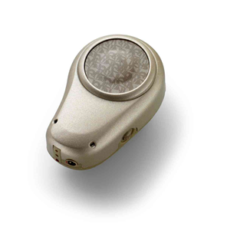
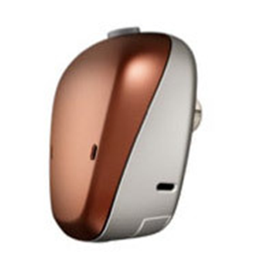
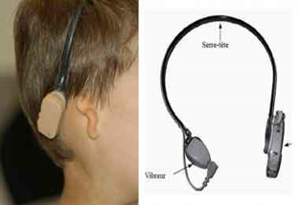
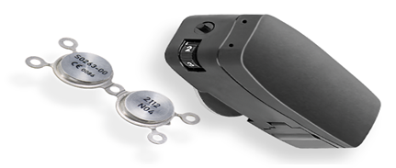
What is an Osseointegrated Hearing Device?
Implantable alternative hearing instrument when traditional amplification options are not feasible
Bone conduction hearing device
Can be implanted/worn on head band
Notes:
Like Dr. Isildak mentioned, Osseointegrated hearing devices are an implantable alternative to traditional amplification, when hearing aids are not a feasible option. Dr. Isildak mentioned the surgical options, and it is important to note that there are additional options, such as on a softband and headband as well.

Slide 4
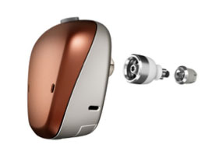
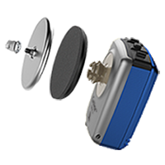
Types of Implants/Devices
2 types of Osseointegrated Devices:
Direct drive systems
Skin drive systems
Notes:
As briefly discussed, Dr. Isildak mentioned that there are multiple types of osseointegrated devices. Direct drive systems are commonly referred to as an abutment and these devices are directly implanted and fuse with the mastoid. They work by directly vibrating the skull to stimulate the cochlea. Skin drive systems include the attract system (or the magnet) as well as the softband/new soundarc options and stimulate the cochlea transcutaneously.

Slide 5
Candidacy
Outer Ear/Middle Ear Malformations
Craniofacial Abnormalities
Chronic Otitis Media/Externa/Otorrhea
Otosclerosis
Trauma
Surgical Ears
Conductive/Mixed Hearing Loss
Single Sided Deafness
Notes:
Again, these devices are for individuals who will not benefit from traditional amplification or cannot wear a traditional hearing aid. People with bahas may have outer/middle ear malformations, such as atresia or otosclerosis/ossicular chain malformations, cranoiofacial abnormalities, such as those associated with syndromes, chronic infections or active drainage where the external canal needs to be opened, Trauma to the ear/temporal bone, surgically altered external canals, CHL/MHL where there are present air-bone gaps, and single sided deafness.

Slide 6
Candidacy
Conductive Hearing Loss
- Air- bone gap of 30dB or greater
Mixed Hearing Loss
Mild to moderate sensorineural component
Air-bone gap
Bone conduction
Pure tone bone conduction threshold equal to or better than 65dBHL (.5k, 1k, 2k, and 3kHz). Devices will vary depending on the bone conduction scores.
Notes:
As Dr. Isildak briefly mentioned, candidacy criteria varies slightly between the adult and pediatric populations. Most protocols for children require the child to be between the ages of 6 and 7 to be deemed surgical candidates. However, prior to that age, headband options are available for children who meet candidacy criteria.
Candidacy criteria for individuals with CHL or MHL require an Air-bone gap of 30 dB or greater.
Pure tone bone conduction scores at 500, 1000, 2000, and 3000 Hz must be 65 dB HL or better.

Slide 7
Candidacy
Single Sided Deafness
Normal hearing in one ear with a pure tone average (measured at .5k, 1k, 2k, and 3kHz) of better than or equal to 20 dBHL)
Unilateral profound hearing loss in the contralateral ear
Notes:
Single-sided deafness candidacy requires there to be one normal hearing ear in which the pure tone average is measured at 500, 1000, 2000, and 3000 Hz, and unilateral hearing loss in the other ear.

Slide 8
Bilateral Devices (Bosman et al., 2001; Dutt et al., 2002; Hagr, 2007; Iwasaki et al., 2005)
Deformities in both ears
Active drainage in both ears
Conductive/Mixed hearing Loss in both ears
Notes:
Bilateral devices can be implanted or worn on a headband for reasons such as deformities in both ears, such as atresia, someone with active drainage in both ears who cannot utilize traditional amplification. Additionally, individuals with bilateral conductive or mixed hearing losses.
There are studies that have evaluated pre- and post- outcomes using behavioral testing and questionnaires and have reported Improved ability to localize with bilateral osseointegrated devices, improved abilities in background noise, as well as better speech understanding and quality of life.
How do we know what side to implant first? Does insurance cover both at once?

Slide 9
Evaluation/Assessment
Meets FDA criteria
Pre- Post Subjective Questionnaire
Bern Benefit Single Sided Deafness
Single Sided Deafness, (SSQ 12)
Testing with the device selection
In situ Bone conduction testing
Speech in noise
Notes:
The evaluation process of these potential candidates is important, as FDA criteria may be needed for insurance reimbursement purposes. Evaluations and protocols will vary between clinics, but commonly an evaluation requires the use of questionnaires, behavioral testing, and speech in noise tests with various listening conditions. At our facility, we make sure we have a full audiologic evaluation, if one has not been completed prior. On the audiogram, we are looking to see if the patient has single sided deafness, a conductive hearing loss, or mixed hearing loss. Then we are looking to see if the air-bone gaps are 30 dB HL or greater at the pure tone averaged frequencies and if that sensorineural component is at least mild to moderate.
Once we finish audiologic testing, we program the BAHA device and perform in-situ BC measurements. It is important when doing in situ measurements to test all of the frequencies including inter-octaves, because it provides more frequencies and better sound quality.
After in-situ measurements, we will do aided sound field testing utilizing narrow-band noise stimuli to establish aided benefit with the BAHA on.
The next portion of the evaluation includes the use of speech in noise testing. There are various clinically available tests that can be utilized. We use the AZ BIO sentence lists at our facility. We test the patient in multiple signal-to-noise ratio conditions, including AZ BIO lists in quiet, +10 dB SNR, +5 dB SNR, and 0 dB SNR with the patient facing 0 degrees azimuth to the noise stimulus and 90 degrees to the speech stimulus. The use of speech in noise tests help to simulate a more realistic listening environment, and can be repeated post-implantation to assess outcomes and benefit.
We repeat this testing with both the soft and hard bands to further determine candidacy for either the attract system or connect system (whether candidate for abutment or magnet). We then refer to our colleagues in Otology to further evaluate for surgical candidacy.
When doing bc direct important to do all frequencies because it really gives you ability to improve sound quality with device on.

Slide 10
Additional Candidacy Considerations
Connect System | Attract System
Maximum retention for active lifestyle | Cosmetically appealing/Discreet
MRI up to 3.0 Tesla | No wound care
Maximum performance | Good for dexterity problems
 | Less risk of implant loss due to trauma

Slide 11
Device Selection Considerations
Need for MRI
Available power
Longevity
Pediatric Considerations
Notes:
With candidacy for kids, you really should consider future need for MRI imaging, and really understand if there kids are actively in sports, an abutment will stick on a lot stronger than a magnet.
Additional considerations, child who has a delay or intellectual disability, it is easier on the caregiver to take care of a softband/BAHA rather than CROS.
Additional device selection considerations For example, what ive seen as a student, individuals will come in and thresholds will be between a 5 and a 5 power. However, you have to look at longevity -the long term- do you want these patients to come in 5 years from now and had a change in hearing and not be able to provide enough power. You want to consider having room to grow with the processor, because you never know if insurance will cover an upgrade. Plus bigger battery is bigger battery life.
Single Sided Deafness
37% failed one grade
62% failed one grade with right sided hearing loss
Risk increased with severity of loss
Increased speech/language delay

Slide 12
Fitting Considerations
Softband/Magnet
Abutment
Feedback
Notes:
When fitting softband or magnet, an audiologist needs to be aware of potential damping effects due to the transcutaneous attenuation of sound.
The gain of the device may need to be increase by approximately 10 dB HL, especially at 1K Hz.
Using an abutment will compensate for this transcutaneous attenuation of sound because it conducts the sound directly to the skull.
We must also be cognizant of feedback and feedback limits. Should be more worried about feedback in patients using power devices. The vibrations from the device will come off of the skull and enter the microphone, creating that feedback loop. If feedback occurs, the audiologist should utilize the feedback manager system in the software.

Slide 13
Validation & Verification
Skull Simulator
B/C direct or software measurements
Booth Testing (Behavioral)
Verifit Test Box
Subjective Measure
Patient/family/teacher reports
Questionnaires
Notes:
Some ways to verify that the device has been fit appropriately are to utilize verification and validation measures.
The validation and verification of these devices is important, just as with traditional hearing aids. Included with BAHA fittings is a skull simulator that allows clinicians and parents/caregivers to be able to listen to the BAHA device and assists with trouble shooting.
Measurements can be obtained in-situ in the software.
Additionally, the use of subjective validation measures, such as questionnaires and reports can be utilized to measure perceived benefit and QOL/validate.
Booth testing should be utilized to determine outcomes and benefits. Which Dr. Isildak will further highlight.

Slide 14
Assistive Technology
Bluetooth technology
Wireless microphones
Phone Clips
TV Streamers
iPhone Connectivity
Notes:
Some additional considerations when fitting patients with BAHA devices are the use of assistive listening devices to assist in adverse listening environments. We now have the ability to for some manufacturers to connect wirelessly to phone clips, tv streamers, and directly with the iphone. This technology allows for signals to be streamed directly into the baha, potentially overcoming the difficulty of background noises.

Slide 15
Outcomes
Condition | Pre- Implant AZ Bio Score
No Device | 5% words correct (7/135 words)
Soft Band | 92% (139/151 words)
Hard Band | 99% (136/127 words)

Slide 16
Outcomes: Post Implant
AzBio +10 SNR | AzBio +5 SNR
99% words correct /135 presented | 92% words correct 139

Slide 17
Alternative Options?
CROS System
BiCROS
Notes:
CROS is a non-surgical option alternative for SSD, and is also an alternative for SSD and when you have a hearing loss in the better hearing ear (which is considered BiCROS). Has both advantages and limitations. Advantage = no surgery Limitation= noise . It is also an option if someone is not ready to discuss surgical options.

Slide 18
References
Bess, F. H. Tharpe. AM Case history data on unilaterally hearing impaired children. Ear Hear 1986;7 (1) 14- 19
English, K . Church. Unilateral hearing loss in children: an update for the 1990s. Lang Speech Hear Serv Sch 1999;3026- 31
McKay S. Gravel, J. S. Tharpe. AM Amplification considerations for children with minimal or mild unilateral hearing loss and unilateral hearing loss. Trends Amplif 2008;12 (1) 43- 5
Cho Lieu, J. MD Speech-Language and Educational Consequences of Unilateral Hearing loss in Children. Arch Otolaryngology Head and Neck 2004; 130(5): 524-530
Transcranial attenuation of bone-conduction when stimulation is at the mastoid and at the bone conduction hearing aid position. Stenfelt S Otol Neurotol. 2012 Feb;33(2) 105-14

Slide 19
Literature Review
Niparko, J.K., Cox, K.M., & Lustig, L.R. (2003). Comparison of the bone anchored hearing aid implantable hearing device with contralateral routing of offside signal amplification in the rehabilitation of unilateral deafness. Otology & Neurotology, 24(1), 73-78.
Vaneecloo, F.M., Ruzza, I., Hanson, J.N., Gerard, T., Dehaussy, J., Cory, M., Arrouet, C., & Vincent, C. (2001). The monaural pseudo-stereophonic hearing aid (BAHA) in unilateral total deafness: a study of 29 patients. Revue de Laryngologie-Otologie-Rhinologie, 122(5), 343-350.
Wazen, J.J., Spitzer, J.B., Ghossaini, S.N., Fayad, J.N., Niparko, J.K., Cox, K.M., Brackmann, D.E., & Soli, S.D. (2003). Transcranial contralateral cochlear stimulation in unilateral deafness. Otolaryngology Head & Neck Surgery, 129(3), 248-254.
Riss, D., Arnoldner, C., Baumgartner, W., Blineder, M., Flak, S., Bachner, A., . . . Hamzavi, J. (2014). Indication criteria and outcomes with the Bonebridge transcutaneous bone-conduction implant. The Laryngoscope, 124(12), 2802-2806. doi:10.1002/lary.24832

Slide 20
Questions ? Thank you Beth Czarnecki, Au.D., CCC/A Director of Audiology Penn State Hershey Medical Center bczarnecki@pennstatehealth.psu.edu Stephanie Malone, B. A. Audiology Extern Penn State Hershey Medical Center smalone@pennstatehealth.psu.edu
Notes:
So at this point I am going to pass this off

